Slide 1
Bank Analysis Dashboard
Prepared by:
Obimezie Chidinma Miracle
Data Analyst Portfolio

Slide 2
Project Overview
Objective: Built a Bank Analytics Dashboard to analyze customer information, including balances, loan amount, account types, loan status, and satisfaction scores, providing interactive insights for better decision-making.
Business Problem: The bank needed a way to quickly analyze customer balances, loan amounts, and other key metrics by gender, city, account type, and loan status. Without an interactive dashboard, gaining these insights would be time-consuming and inefficient.
Tools Used: Microsoft Excel, SQL, Power BI, DAX Measurement

Slide 3
Dataset Description
The dataset contains 17 customer records.
It includes information on Customer ID, Gender, City, Account Type, Loan Status, Satisfaction Score, and Age. It was used to analyze customer profiles and financial performance.

Slide 4
Data Cleaning
Checked for missing values.
Corrected data types where needed.
Prepared the data for analysis.
Created DAX measures.

Slide 5
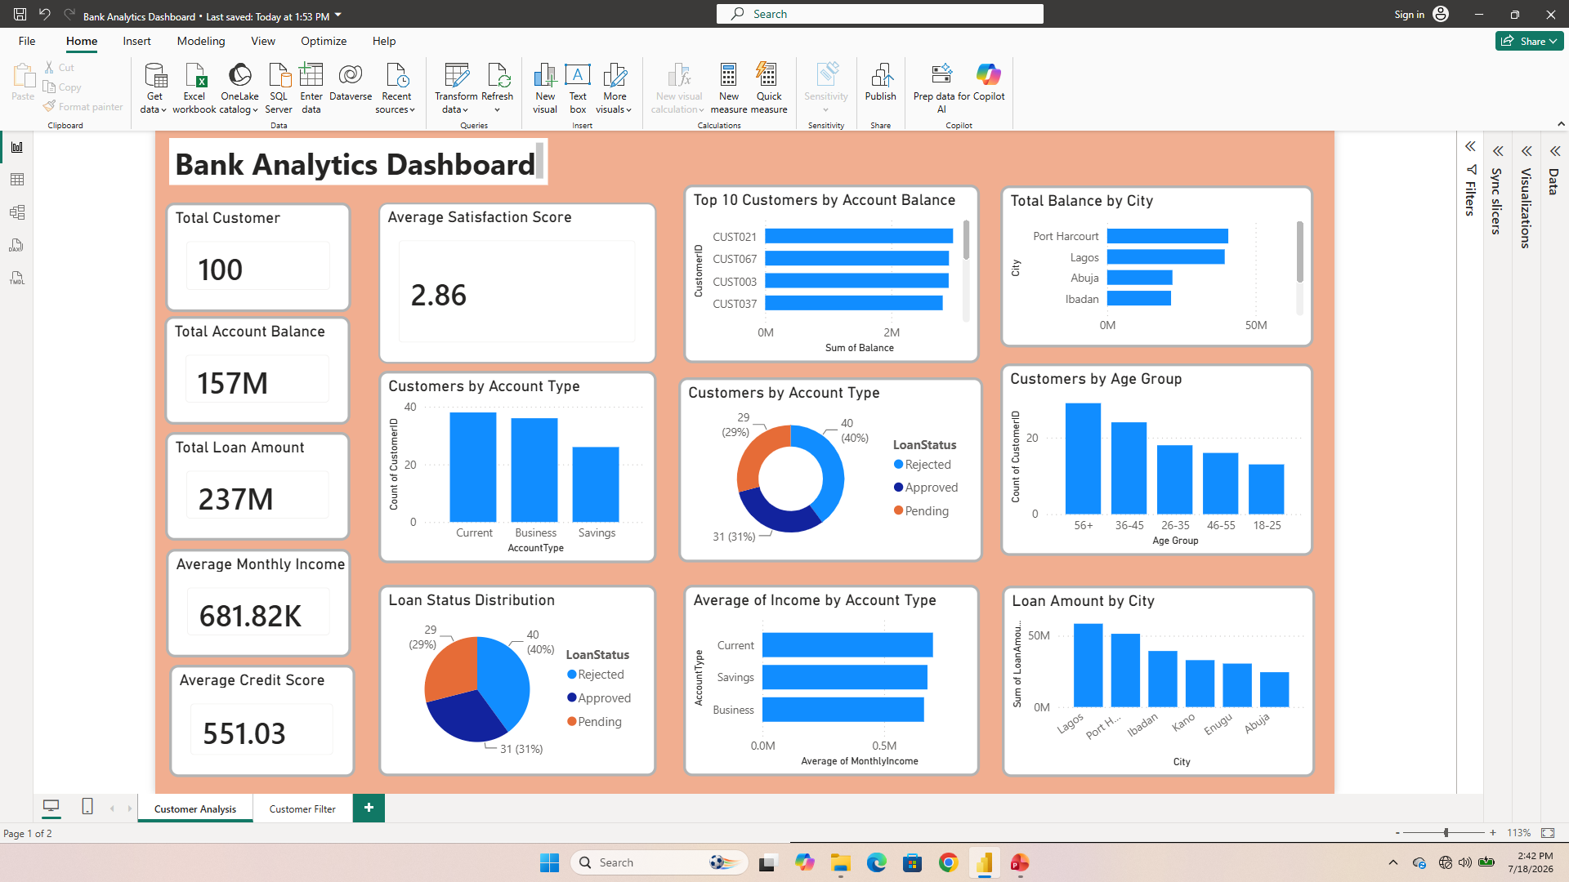
Customer Analysis Dashboard Overview

Slide 6
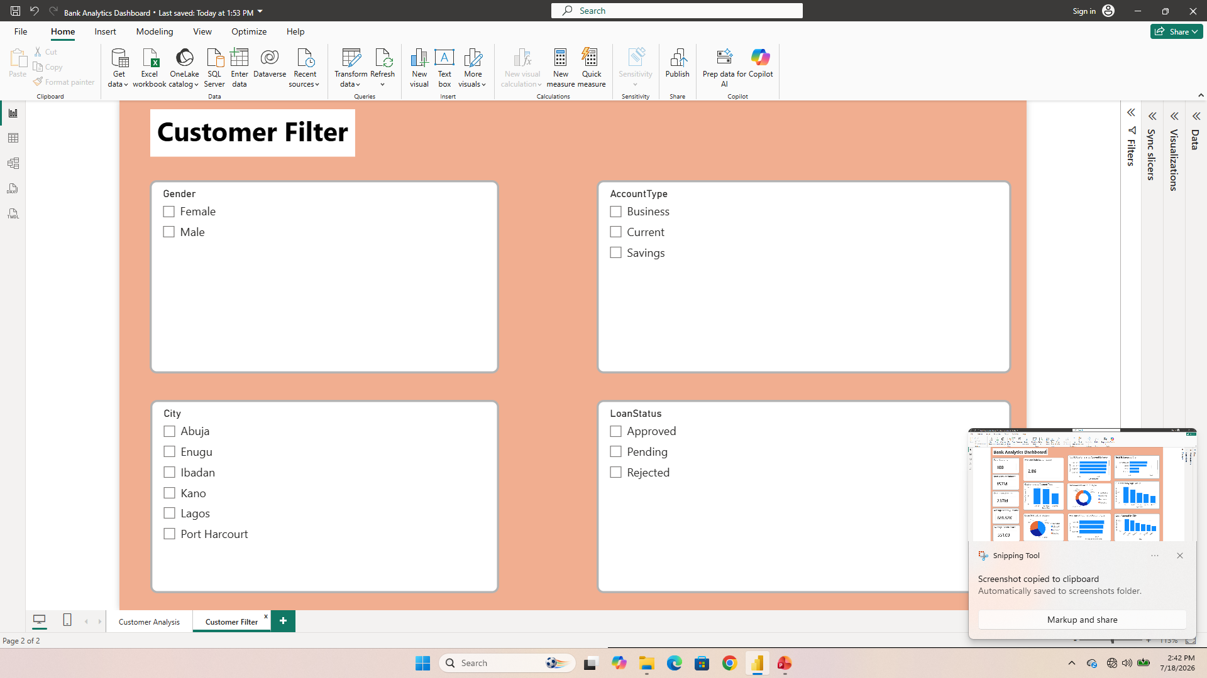
Customer Filter Dashboard

Slide 7
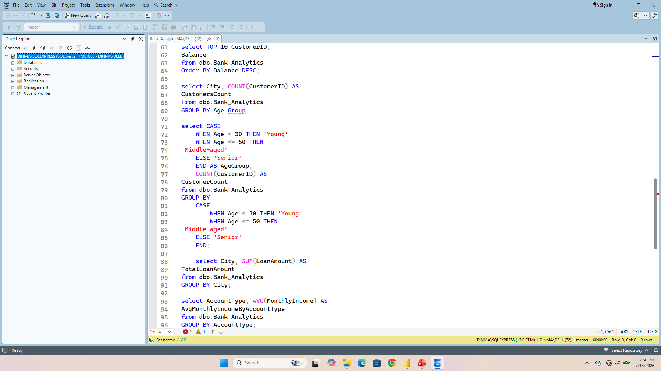
SQL Queries

Slide 8
Key Insights
Total account balance is 157 million.
Total loan amount is 237 million.
The average monthly income is 681.82 thousand.
Port-Harcourt has the highest balance.
The highest age group is 56+.
Rejected loan of 40% is accounted for the largest share of loan applications in the dataset.
Average customer satisfaction score is 2.86.
Current account has the highest average income.
Lagos has the highest loan amount compared to other cities.

Slide 9
Recommendations
Investigate rejected loan applications.
Analyze why Lagos has the highest loan amount.
Continue monitoring customer trends.

Slide 10
Conclusion
The Bank Analytics Dashboard enables the bank staffs to monitor account types, loan status, customer balances, and customer behavior across different cities. These insights support faster analysis helping them make more informed, data-driven decisions.

